Slide 1
Chapter 12
File Management

Slide 2
Files
Data collections created by users
Properties of files:
Long-term existence
Stored in secondary storages, do not disappear when logs off
Sharable between processes
associated permissions that permit controlled sharing
Structure
can be hierarchical or complex structure

Slide 3
File Systems
Store data organized as files as well as a collection of functions that can be performed on files
Maintain a set of attributes associated with the file
Operations: Create, Delete, Open, Close, Read, Write

Slide 4
File Systems
Four terms are commonly used when discussing files:
Field
Record
File
Database

Slide 5
File Systems
Field
basic element of data
contains a single value
fixed or variable length
Record
collection of related fields that can be treated as a unit by some application program
fixed or variable length

Slide 6
File Systems
File
collection of similar records
treated as a single entity
may be referenced by name
access control restrictions usually apply at the file level

Slide 7
File Systems
Database
collection of related data
relationships among elements of data are explicit
designed for use by a number of different applications
consists of one or more types of files

Slide 8
File Management System Objectives
Meet the data management needs of the user
Guarantee that the data in the file are valid
Optimize performance
Provide I/O support for
a variety of storage device types
multiple users in multiple-user systems
Minimize the potential for lost or destroyed data
Provide a standardized set of I/O interface routines to user processes

Slide 9
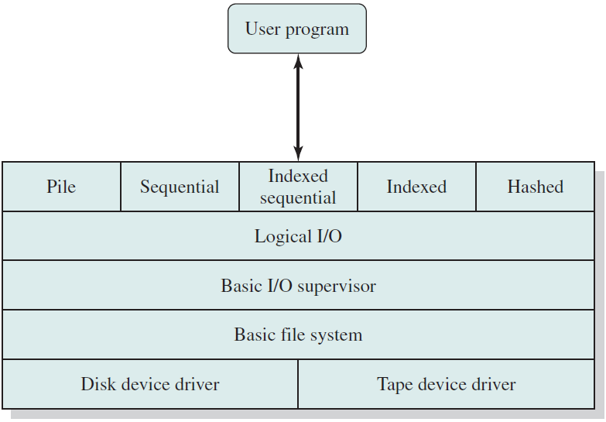
File System Architecture

Slide 10
File System Architecture
Device drivers
Lowest level
Communicates directly with peripheral devices
Responsible for starting I/O operations on a device
Processes the completion of an I/O request
Considered to be part of the operating system

Slide 11
File System Architecture
Basic File System - the physical I/O level
Primary interface with the environment outside the computer system
Deals with blocks of data that are exchanged with disk or tape systems
Concerned with
the placement of blocks on the secondary storage device
buffering blocks in main memory
Part of the operating system

Slide 12
File System Architecture
Basic I/O Supervisor
Responsible for all I/O initiation and termination
Control structures that deal with device I/O, scheduling, and file status are maintained
Selects the device on which I/O is to be performed
Concerned with scheduling to optimize performance

Slide 13
File System Architecture
Basic I/O Supervisor
Assign I/O buffers and allocate secondary memory
Part of the operating system

Slide 14
File System Architecture
Logical I/O
Enable users and applications to access records
Provide general purpose record I/O capability
Maintain basic data about file

Slide 15
File System Architecture
Access Method
Level of the file system closest to the user
Provides a standard interface between applications and the file systems and devices that hold the data
Different access methods reflect different file structures and different ways of accessing and processing the data

Slide 16
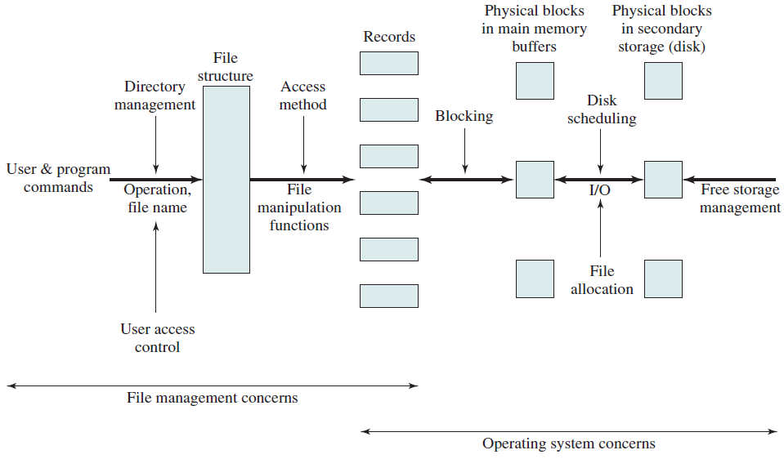
File Management Functions

Slide 17
File Organisation and Access
File organisation: logical structuring of the records as determined by the way in which they are accessed.
Several criteria in choosing a file organisation:
short access time
ease of update
economy of storage
simple maintenance
reliability

Slide 18
File Organisation and Access
File organisation types:
Pile
Sequential file
Indexed sequential file
Indexed file
Direct or hashed file

Slide 19
File Organisation and Access
Organisation types: the pile
Least complicated form of file organization
Data are collected in the order they arrive
Each record consists of one burst of data
Purpose is simply to accumulate the mass of data and save it
Record access is by exhaustive search

Slide 20
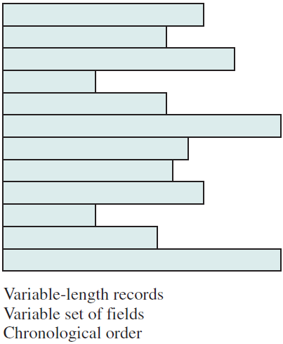
File Organisation and Access
Organisation types: the pile

Slide 21
File Organisation and Access
Organisation types: sequential file
Most common form of file structure
A fixed format is used for records
Key field uniquely identifies the record
Typically used in batch applications
Only organisation that is easily stored on tape as well as disk

Slide 22
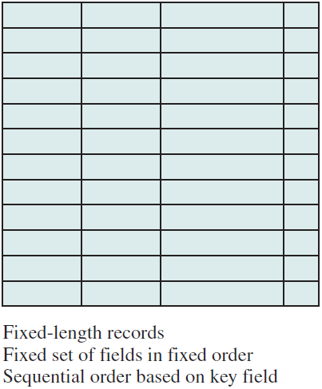
File Organisation and Access
Organisation types: sequential file

Slide 23
File Organisation and Access
Organisation types: indexed sequential file
Adds an index to the file to support random access
Adds an overflow file – a new record in the overflow file is located by following a pointer from its predecessor record
Greatly reduces the time required to access a single record
Multiple levels of indexing can be used to provide greater efficiency in access

Slide 24
File Organisation and Access
Organisation types: indexed sequential file
Single level of indexing
Index file is a simple sequential file, 2 fields in a record:
key field, which is the same as the key field in the main file
a pointer into the main file
To find a specific field, the index is searched to find the highest key value that is equal to or precedes the desired key value.
The search continues in the main file at the location indicated indicated by the pointer.

Slide 25
File Organisation and Access
Organisation types: indexed sequential file
Single level of indexing
Each record in main file contains a pointer to overflow file.
New record is added into the overflow file
The record in the main file that immediately precedes the new record is updated to contain a pointer to the new record.
The indexed sequential file is merged with the overflow file in batch mode.

Slide 26
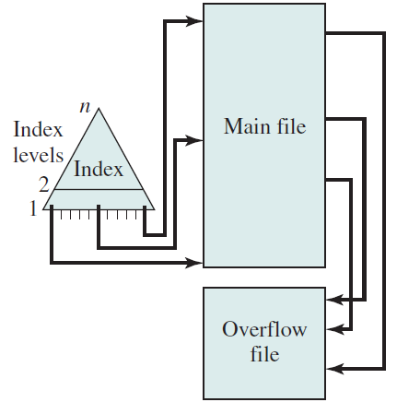
File Organisation and Access
Organisation types: indexed sequential file

Slide 27
File Organisation and Access
Organisation types: Indexed file
Records are accessed only through their indexes
Variable-length records can be employed
Two types of indexes:
Exhaustive index contains one entry for every record in the main file
Partial index contains entries to records where the field of interest exists

Slide 28
File Organisation and Access
Organisation types: Indexed file
When a new record is added to the main file, all index files must be updated.
Used mostly in applications where timeliness of information is critical. Examples:
airline reservation systems
inventory control systems

Slide 29
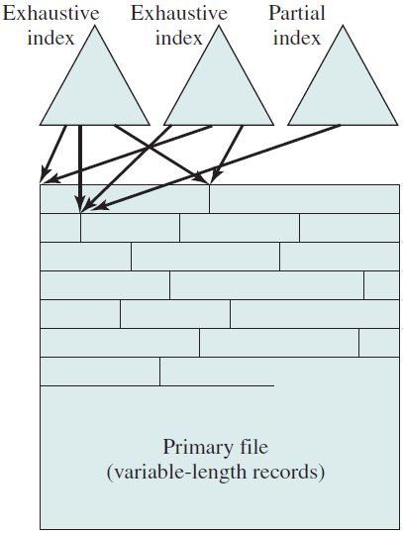
File Organisation and Access
Organisation types: Indexed file

Slide 30
File Organisation and Access
Organisation types: Direct / hashed file
Access directly any block of a known address
Makes use of hashing on the key value
Often used where:
very rapid access is required
fixed-length records are used
records are always accessed one at a time

Slide 31
File Organisation and Access
Organisation types: B-trees
A balanced tree structure with all branches of equal length
Standard method of organizing indexes for databases
Commonly used in OS file systems
Provides for efficient searching, adding, and deleting of items

Slide 32
File Organisation and Access
Organisation types: B-trees Characteristics
every node has at most 2d – 1 keys and 2d children or, equivalently, 2d pointers (d degree tree)
every node, except for the root, has at least d – 1 keys and d pointers (each node, except the root, is at least half full and has at least d children)
the root has at least 1 key and 2 children

Slide 33
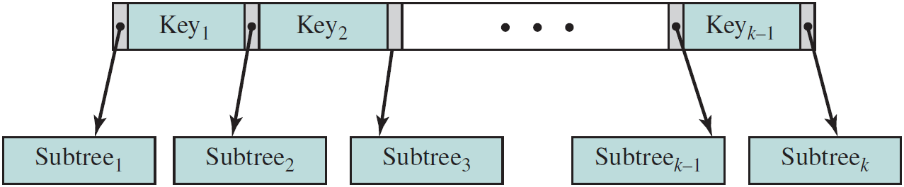
File Organisation and Access
Organisation types: B-trees Characteristics
all leaves appear on the same level and contain no information.
A non-leaf node with k pointers contains k – 1 keys

Slide 34
File Organisation and Access
Organisation types: B-trees
Start to search for a key at root node, if the key is in the node, done. Else, go down one level. 3 cases:
The key is less then the smallest key in this node. Take the leftmost pointer down to the next level.
The key is greater than the largest key in this node. Take the rightmost pointer down to the next level.
The value of the key is between the values of two adjacent keys in this node. Take the pointer between these keys down to the next level.

Slide 35
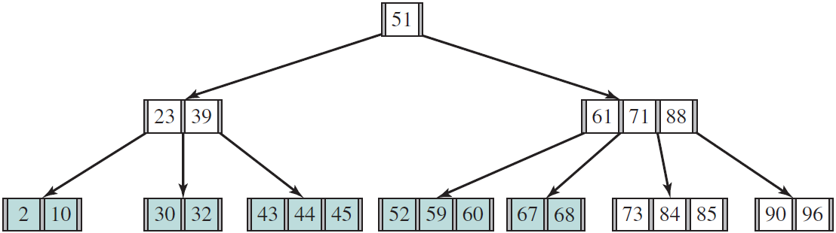
File Organisation and Access
Organisation types: B-trees
Example: search for key 84.
Root = 51 (<84), take the rightmost branch.
71 < 84 < 88, take the pointer between 71 and 88 to next level

Slide 36
File Organisation and Access
Organisation types: B-trees
To insert new key
Search the tree for the key. If not found, then you have reached a node at the lowest level.
If the node has < 2d - 1 keys, insert the key into this node in the proper sequence.
If the node is full, split the node around its median key into two new nodes with d - 1 keys each and promote the median key to the next higher level. If new key < median key, insert to left node, else insert to right node.

Slide 37
File Organisation and Access
Organisation types: B-trees
To insert new key
The promoted node is inserted into the parent node following the rules of step 3.
If the process of promotion reaches the root node and the root node is already full, then insertion again follows the rules of step 3. In this case the median key becomes a new root node and the height of the tree increases by 1.

Slide 38
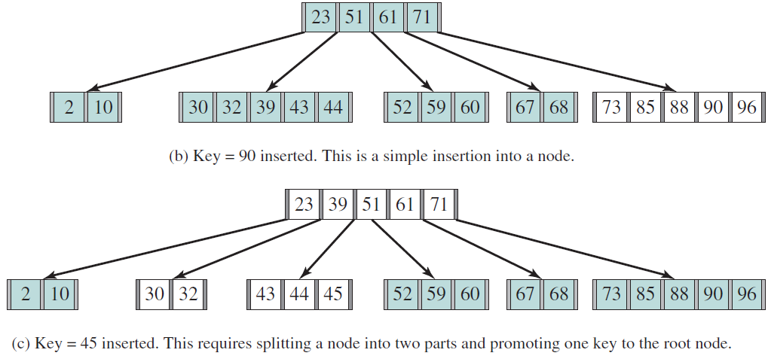
File Organisation and Access
Organisation types: B-trees

Slide 39
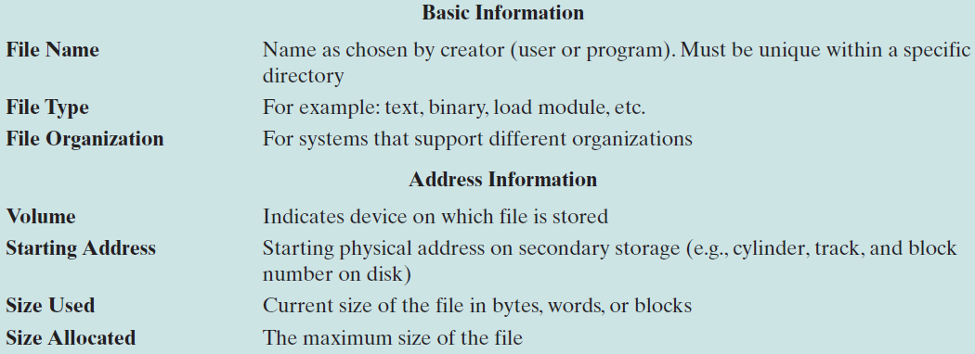
File Directories
A file that contains information about the files.
Notes:
AST

Slide 40
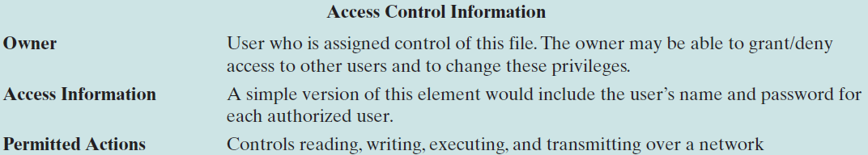
File Directories
A file that contains information about the files.
Notes:
AST

Slide 41
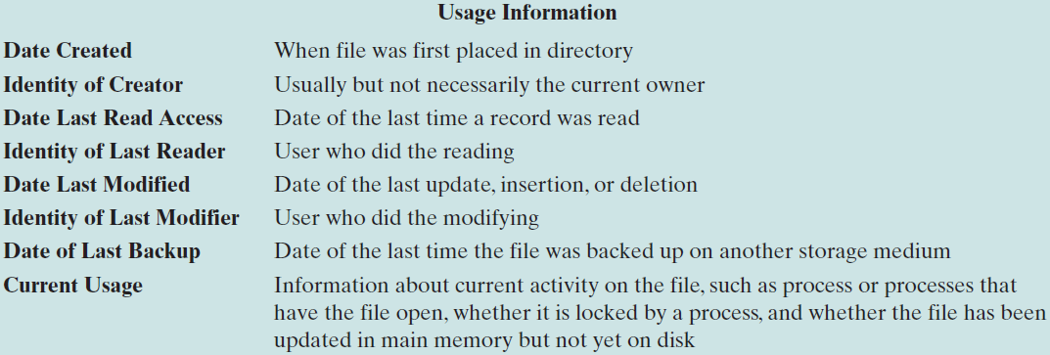
File Directories
A file that contains information about the files.
Notes:
AST

Slide 42
File Directories
Operations performed on directories:
Search
Create file - an entry must be added to the directory for newly created file
Delete file - entry must be removed from directory when a file is deleted
List directory
Update directory
Notes:
AST

Slide 43
File Directories
Directory as simple list
forces the user to be careful not to use the same name for two different types of files.
The problem is much worse in a shared system.
Notes:
AST

Slide 44
File Directories
Two-level scheme
There is one directory for each user and a master directory.
Master directory has an entry for each user directory providing address and access control information
Each user directory is a simple list of the files
Names must be unique within the user directory
File system can easily enforce access restriction on directories
Notes:
AST

Slide 45
File Directories
Tree structure
There is a master directory, which has a number of user directories under it.
User directories may have subdirectories and files
Notes:
AST

Slide 46
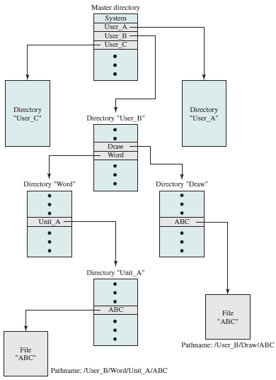
File Directories
Notes:
AST

Slide 47
File Sharing
Two issues
access rights
management of simultaneous access
Notes:
AST

Slide 48
File Sharing – Access Right
None
user would not be allowed to read the user directory that includes the file
Knowledge
user can determine existence of file its owner
Execution
user can load and execute a program but can’t copy it
Notes:
AST

Slide 49
File Sharing – Access Right
Reading
user can read, copy and execute the file
Appending
user can add data to the file but cannot modify or delete the file’s contents
Updating
user can modify, delete, and add to the file’s data
Notes:
AST

Slide 50
File Sharing – Access Right
Changing protect
User can change the access rights granted to other users.
Deletion
User can delete the file from the file system.
Notes:
AST

Slide 51
File Sharing – Access Right
Provided to different classes of users
Specific user - individual users who are designated by user ID.
User groups - a set of users who are not individually defined.
All - all users who have access to this system. These are public files.
Notes:
AST

Slide 52
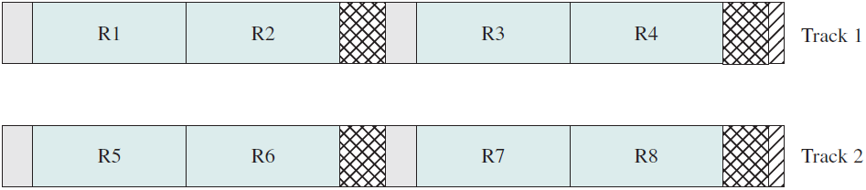
Record Blocking
Blocks are the unit of I/O with secondary storage. 3 methods of blocking
Fixed-Length Blocking
Fixed-length records are used.
Internal fragmentation.
Notes:
AST

Slide 53
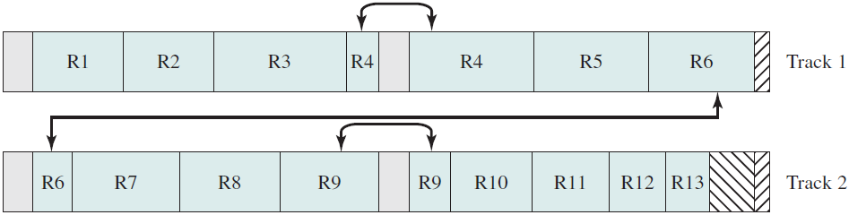
Record Blocking
Blocks are the unit of I/O with secondary storage. 3 methods of blocking
Variable-Length Spanned Blocking
variable-length records are used and are packed into blocks with no unused space
Notes:
AST

Slide 54
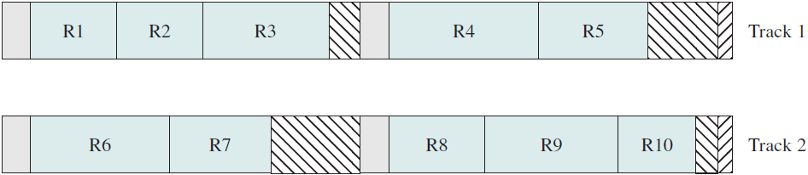
Record Blocking
Blocks are the unit of I/O with secondary storage. 3 methods of blocking
Variable-Length Unspanned Blocking
variable-length records are used , but spanning is not employed
Notes:
AST

Slide 55
File Allocation
File consists of a collection of blocks.
The OS or file management system is responsible for allocating blocks to files.
Issues in file allocation:
When a file is created, is the maximum space required for the file allocated at once?
Preallocation or dynamic allocation
Notes:
AST

Slide 56
File Allocation
Issues in file allocation:
Space is allocated to a file as one or more portions (contiguous set of allocated blocks). What size of portion should be used for file allocation?
What sort of data structure or table is used to keep track of the portions assigned to a file? Example, FAT
Notes:
AST

Slide 57
File Allocation
Preallocation
The maximum size of a file declared at the time of creation
Difficult to estimate reliably the maximum potential size of the file
Tends to be wasteful because users and application programmers tend to overestimate size.
Dynamic allocation allocates space to a file in portions as needed.
Notes:
AST

Slide 58
File Allocation
Portion size allocated. Items to be considered:
Contiguity of space increases performance and greatly for transactions running in a transaction-oriented operating system.
Having a large number of small portions increases the size of tables needed to manage the allocation information.
Notes:
AST

Slide 59
File Allocation
Portion size allocated. Items to be considered:
Having fixed-size portions simplifies the reallocation of space.
Having variable-size or small fixed-size portions minimizes waste of unused storage.
2 alternatives:
Variable, large contiguous portions
Blocks
Notes:
AST

Slide 60
File Allocation
Variable, large contiguous portions
Provides better performance.
The variable size avoids waste.
The file allocation tables are small.
Blocks
Small fixed portions provide greater flexibility.
May require large tables or complex structures for their allocation.
Blocks are allocated as needed.
Notes:
AST

Slide 61
File Allocation Methods
3 common methods:
Contiguous
Chained
Indexed
Notes:
AST

Slide 62
File Allocation Methods
Contiguous allocation
a single contiguous set of blocks is allocated to a file at the time of file creation
preallocation strategy, using variable-size portions.
Only a single entry in the file allocation table, showing the starting block and the length of the file
External fragmentation will occur, difficult to find contiguous blocks of space of sufficient length
need to perform compaction.
Notes:
AST

Slide 63
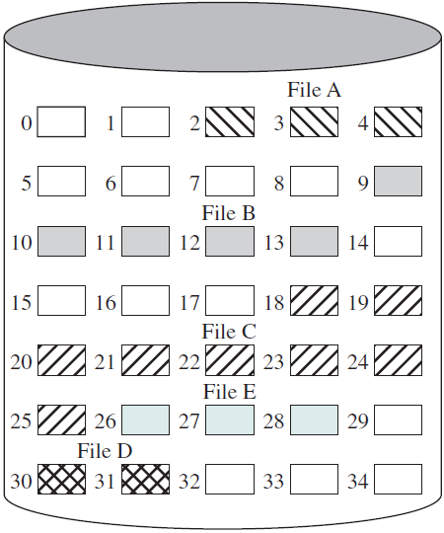
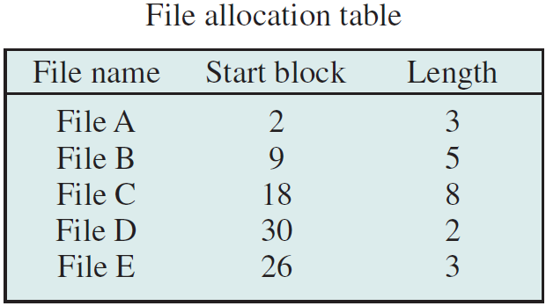
File Allocation Methods
Contiguous allocation – before compaction
Notes:
AST

Slide 64
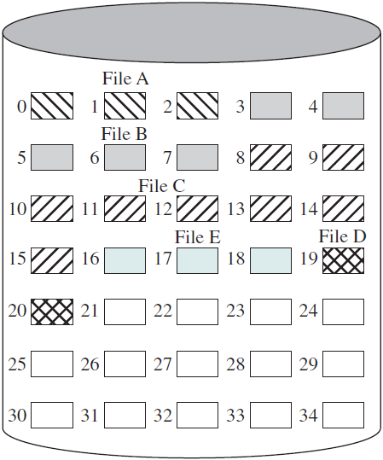
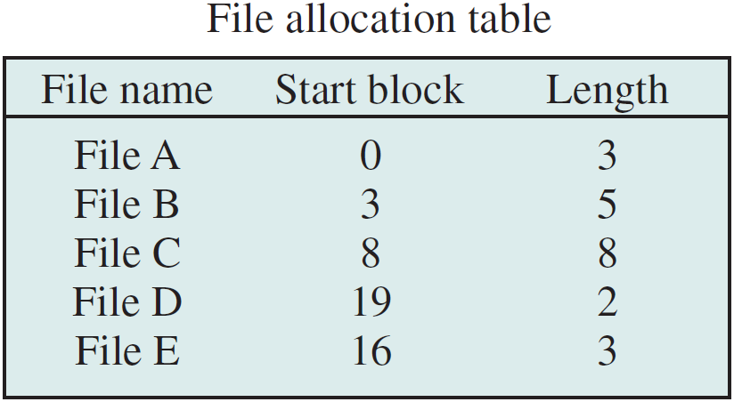
File Allocation Methods
Contiguous allocation – after compaction
Notes:
AST

Slide 65
File Allocation Methods
Chained allocation
Allocation on basis of individual block
Any free block can be added - no external fragmentation
Each block contains a pointer to the next block in the chain
Only single entry in the file allocation table, showing the starting block and the length of the file.
Best for sequential files
No accommodation of the principle of locality
Notes:
AST

Slide 66
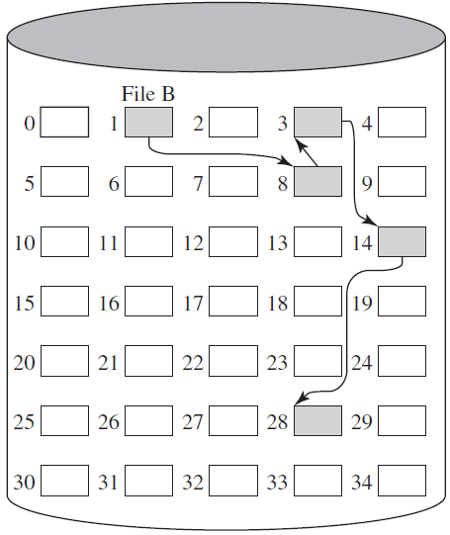
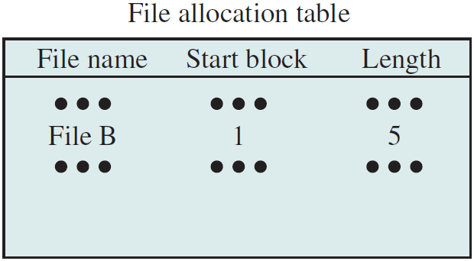
File Allocation Methods
Chained allocation
Notes:
AST

Slide 67
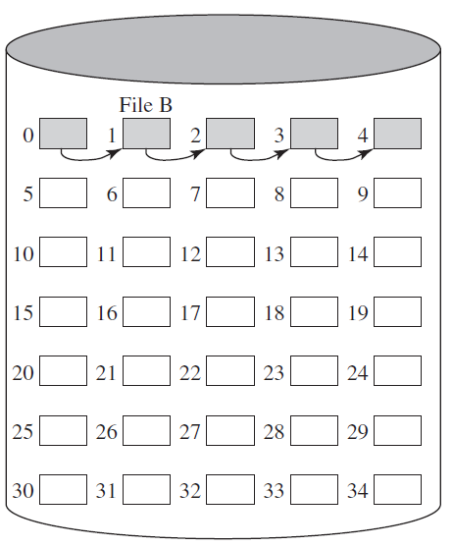
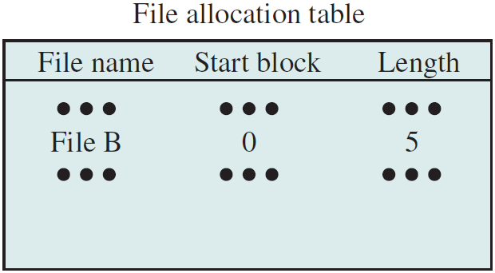
File Allocation Methods
Chained allocation – after consolidation
Notes:
AST

Slide 68
File Allocation Methods
Indexed allocation
File allocation table contains a separate one-level index for each file
the index has one entry for each portion allocated to the file
File index for a file is kept in a separate block, and the entry for the file in the file allocation table points to that block.
Consolidation may be done from time to time.
Notes:
AST

Slide 69
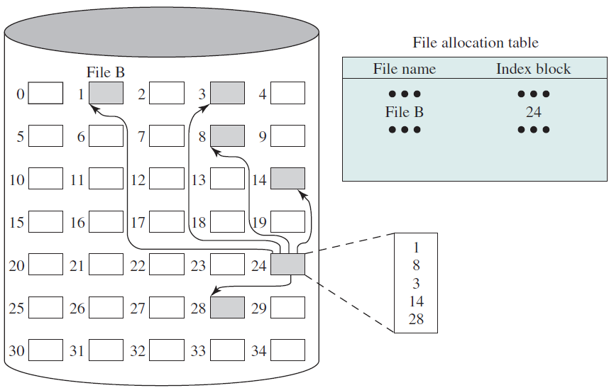
File Allocation Methods
Indexed allocation with block portions
Notes:
AST

Slide 70
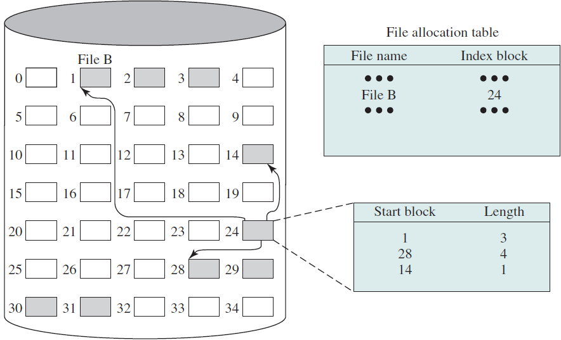
File Allocation Methods
Indexed allocation with Variable-Length portions
Notes:
AST

Slide 71
Free Space Management
A disk allocation table is needed in addition to a file allocation table.
To know which blocks are available.
Techniques implemented:
Bit tables
Chained Free Portions
Indexing
Free Block List
Volumes
Notes:
AST

Slide 72
Free Space Management
Bit tables
Uses a vector containing one bit for each block on the disk.
0: free block
1: block in use
Advantages:
Works well with any file allocation method.
It is as small as possible.
Notes:
AST

Slide 73
Free Space Management
Bit tables
Example: 00111000011111000011111111111011000
Notes:
AST

Slide 74
Free Space Management
Chained Free Portions
Free portions may be chained together by using a pointer and length value in each free portion.
Negligible space overhead because there is no need for a disk allocation table.
Notes:
AST

Slide 75
Free Space Management
Chained Free Portions
Suited to all file allocation methods.
Block allocation: simply choose the free block at the head of the chain and adjust the first pointer or length value.
Variable-length portions allocation: headers from the portions are fetched one at a time to determine the next suitable free portion
Notes:
AST

Slide 76
Free Space Management
Chained Free Portions
Disadvantages:
Leads to fragmentation.
Every block allocation requires reading the block first to recover the pointer to the new first free block before writing data to that block.
Notes:
AST

Slide 77
Free Space Management
Indexing
Treats free space as a file and uses an index table as it would for file allocation.
For efficiency, the index should be on the basis of variable-size portions rather than blocks.
Provides efficient support for all of the file allocation methods.
Notes:
AST

Slide 78
Free Space Management
Free Block List
Each block is assigned a number sequentially.
The list of the numbers of all free blocks is maintained in a reserved portion of the disk.
Depending on the size of the disk, 24 or 32 bits will be needed to store a single block number
the size of the free block list is 24 or 32 times the size of the corresponding bit table and must be stored on disk
Notes:
AST

Slide 79
Free Space Management
Free Block List
2 effective techniques for storing a small part of the free block list in main memory:
Treat the list as a push-down stack with the first few thousand elements of the stack kept in main memory
Treat the list as a FIFO queue, with a few thousand entries from both the head and the tail of the queue in main memory
Transfer between disk and main memory occurs when the in-memory portion becomes either full or empty
Notes:
AST

Slide 80
Free Space Management
Volume
A collection of addressable sectors in secondary memory that an OS or application can use for data storage.
The sectors in a volume need not be consecutive on a physical storage device.
A volume may be the result of assembling and merging smaller volumes.
Notes:
AST

Slide 81
Free Space Management
Reliability: Consider the following scenario
User A requests a file allocation to add to an existing file.
Request is granted and the disk and file allocation tables are updated in main memory but not yet on disk.
The system crashes and subsequently restarts.
Notes:
AST

Slide 82
Free Space Management
Reliability: Consider the following scenario
User B requests a file allocation and is allocated space on disk that overlaps the last allocation to user A.
User A accesses the overlapped portion via a reference that is stored inside A’s file.
Notes:
AST

Slide 83
Free Space Management
Reliability - to prevent this type of error
Lock the disk allocation table on disk.
Search the disk allocation table for available space. Assumes that a copy of the disk allocation table is always kept in main memory.
Allocate space, update the disk allocation table, and update the disk.
Update the file allocation table and update the disk.
Unlock the disk allocation table.
Notes:
AST

Slide 84
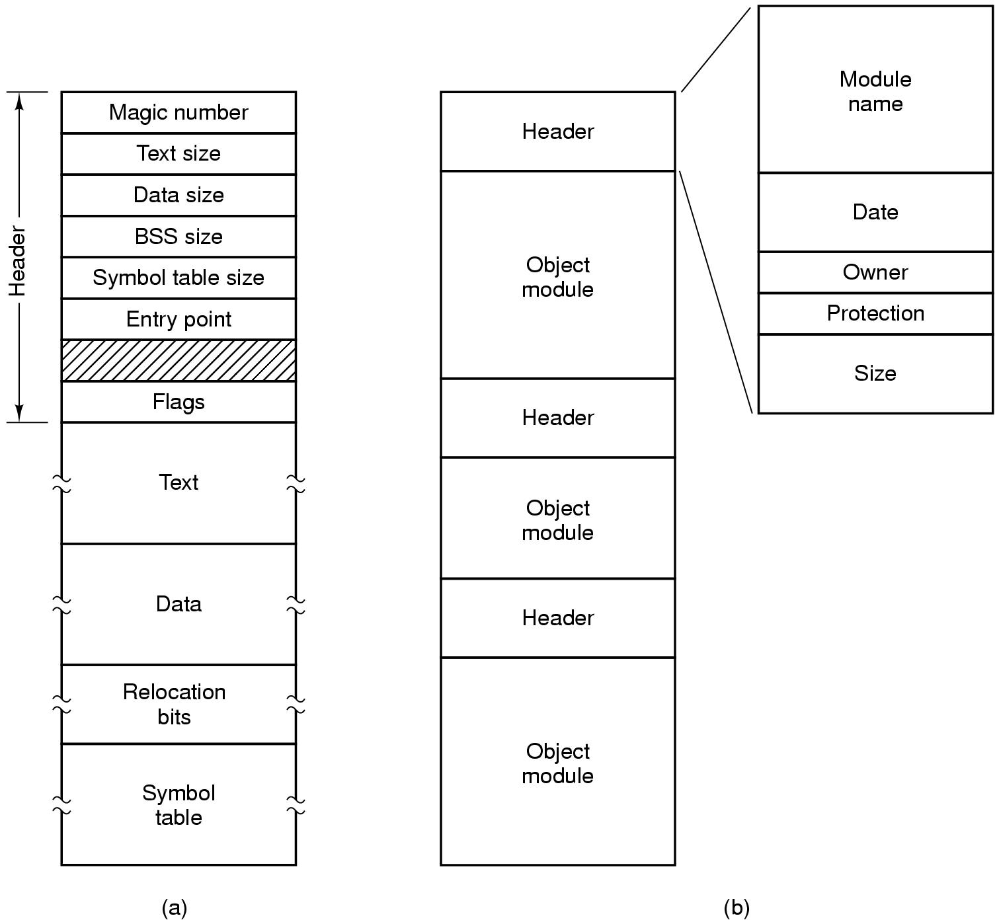
File Types
Binary file structure
Archive file structure
Notes:
AST

Slide 85
File Types
Magic number – used to identify file type
Examples:
DOS executables – MZ (initials of Mark Zbikwoski, former Microsoft architect, designer of DOS executable file format)
GIF image files – GIF89a or GIF87a
JPEG image files – start with 0xFFD8 and end with 0xFFD9
PostScript files and programs start with ‘%!’ (0x2521)
PDF files start with ‘%PDF’ (0x25504446)
Notes:
AST

Slide 86
Hierarchical, or Tree-Structured Directory
Files can be located by following a path from the root, or master, directory down various branches
This is the pathname for the file
Can have several files with the same file name as long as they have unique path names
Current directory is the working directory
Files are referenced relative to the working directory

